Slide 1
Course Application Processing System (CAPS)

Slide 2

Hello!
We are from Team 10
Ng Yan Bo​
Tan Qiu Hui​
Lee Kai Seng​
Zhao Pengkai​
Sun Chengyuan​
Tran Thi Ngoc Thuy​
Geraldine Tay Hui Ling​
Priyanga Thiruneelakandan​
Shalin Christina Stephen Selvaraja​

Slide 3
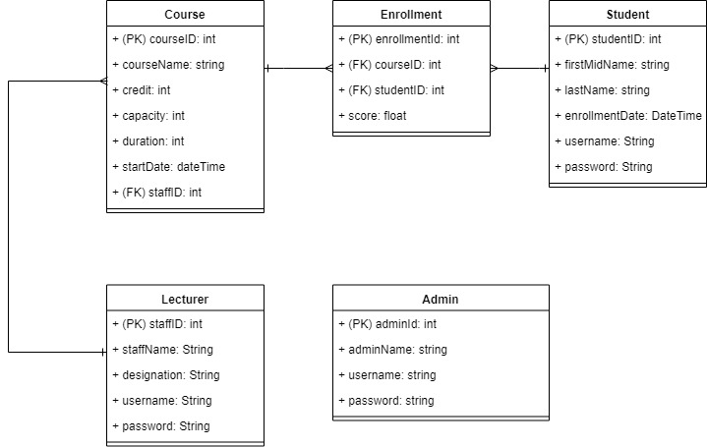
ER-Diagram

Slide 4
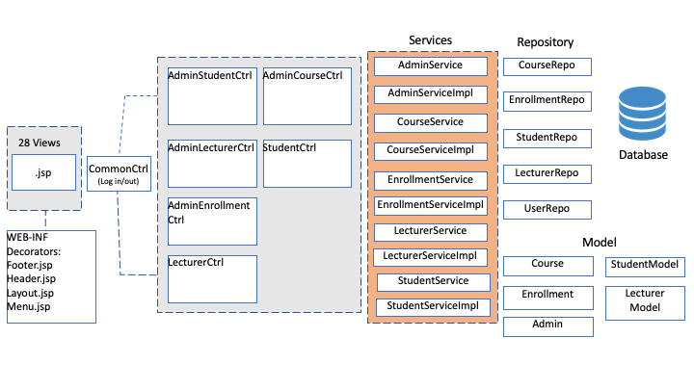
Architecture

Slide 5
Learning Points
Team collaboration through GitHub
Implementing a Spring Boot MVC project
Using Annotations
Entity Mapping
Front end and back end validation
Security Configuration - limiting access to webpages based on different user roles
Creating Search Bar and Dropdown List
Using CSS Javascript and Bootstrap

Slide 6
Thank you!
Hope you enjoyed our presentation

